Slide 1


<Name>
<Date>

Slide 2

Outline
Executive Summary
Introduction
Methodology
Results
Conclusion
Appendix

Slide 3
Executive Summary
We used rocket launch data from the spaceX API
We predict the likelihood of a successful rocked stage 1 landing based on launch-site, weight, orbit.
We found out that the payload correlates with the success rate. The higher the payload, the more likely is a successful landing
Launching the rockets in some orbits make it more likely that the landing will succeed.

Slide 4
Introduction
Rocket launches are very expensive. Reusing the first stage of the rocket reduces the price for the launch.
How can we optimize the number of successful landings of stage 1.

Slide 5


Slide 6
Methodology
Executive Summary
Data collection methodology:
We used the SpaceX API and web-scrapping to get the data.
Perform data wrangling
We cleaned the data and reduced it to a relevant dataset
Perform exploratory data analysis (EDA) using visualization and SQL
Perform interactive visual analytics using Folium and Plotly Dash
Perform predictive analysis using classification models
We broke the data into train and test sets to train the predictive model and then test how well it predicts.

Slide 7
Data Collection
Primary data was collected through the SpaceX API
additional information got scrapped from wikipedia
dataset
SpaceX API
Wikipedia

Slide 8
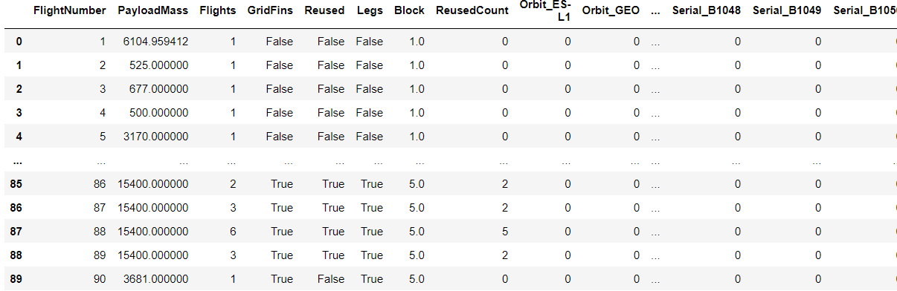
Data Collection – SpaceX API
Called the spaceX API to get the data.
https://github.com/Supertyp/spaceibm/blob/79382cfb1aacf51db2c2d0a9f0d542e8b39ab7d3/capstone%20project%20space%20Y%20notebook.ipynb
Place your flowchart of SpaceX API calls here
Watson Studio
API

Slide 9
Data Collection - Scraping
Used beautifulsoup to get data out of the Wikipedia HTML page for Falcon landings
The data was included in a table on the website, beautifulsoup enabled us to get the data into a format we can process
https://github.com/Supertyp/spaceibm/blob/master/web%20scrapping%20for%20space%20Y.ipynb
Watson Studio
Wikipedia
Place your flowchart of web scraping here
Get table data using beautiful soup
Get data into pandas format

Slide 10
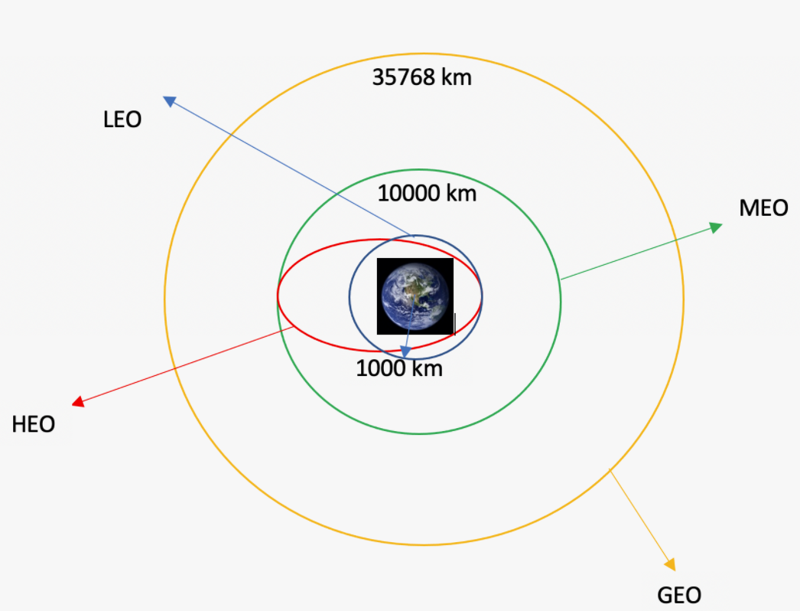
Data Wrangling
Calculated the landing outcome of every launch and added it to the dataset as “Class” column. Also included the orbits as category.
We ensured each column has the correct data type.
We transformed the data to a YYYY-MM-DD format
We added a categorical column called “class” for successful
failed landings
Where necessary, we turned the data into categorical data
https://github.com/Supertyp/spaceibm/blob/master/data%20wrangling.ipynb

Slide 11
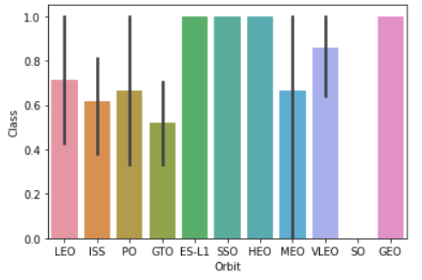
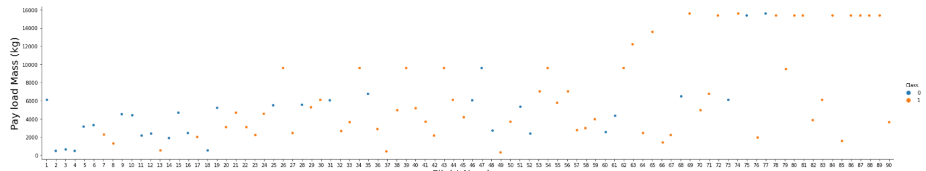
EDA with Data Visualization
We got the landing outcome depending on payload, orbit and launch site.
We used scatterplots and bar charts to visualize the results.
https://github.com/Supertyp/spaceibm/blob/master/data%20vis%20with%20matplotlib.ipynb

Slide 12
EDA with SQL
We used SQL magic in the Jupiter notebook to query for launchsites, payloads, when the first successful landing was archived, name of boosters.
We particularly made use of SELECT FROM, WHERE, BETWEEN, ORDER BY, DESC commands
e.g.: %sql select BOOSTER_VERSION from SPACEXTBL where LANDING__OUTCOME='Success (drone ship)' and PAYLOAD_MASS__KG_ BETWEEN 4000 and 6000
To get the the names of the boosters which have success in drone ship and have payload mass greater than 4000 but less than 6000
https://github.com/Supertyp/spaceibm/blob/master/landing%20sql%20tutorial.ipynb

Slide 13
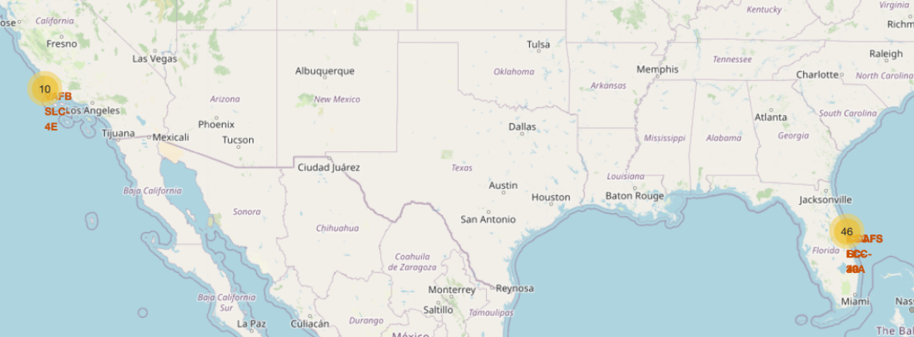
Build an Interactive Map with Folium
We added the stating and landing locations as markers on the map. One can now zoom in to see the location in detail.
We added circles to indicate the launch sites on the map and added markers for the name
This way, the locations are easy to spot and the information easy to read out of the map
The locations collapse into a number when you zoom out so the map is not clustered with markers
https://github.com/Supertyp/spaceibm/blob/master/Data%20dashboard%20with%20folium.ipynb

Slide 14
Build a Dashboard with Plotly Dash
The dashboard has a dropdown for the starting locations and a slider to filter the results for the payload of the rocket
It shows a pie chart and a scatterplot as the results.
The pie chart shows the percentage of successful landings.
The scatterplot shows the success count by payload
https://github.com/Supertyp/spaceibm/blob/master/spacex_dash_app.py

Slide 15
Predictive Analysis (Classification)
We split the data into train and test set to train and test the model
We plotted a confusion matrix to visualize the write and wrong predictions
We used logistic regression, Nearest neighbour and GridSearch to predict the landing class.
For the nearest neighbor we tried all from 1-10 neighboors and then did a Gridsearch. We found out the model best performs when it takes 10 nearest neighbours into account.
It predicted the outcome with a accuracy of 84%
https://github.com/Supertyp/spaceibm/blob/master/predictive%20model.ipynb

Slide 16
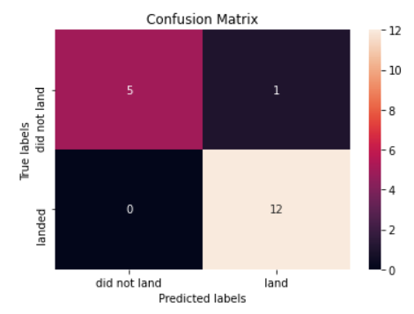
Results
We created the confusion matrix for the different approaches which are all based on a decision tree
The best result is shown on the right
The best accuracy stands at 84% for lr_score,svm_score,knn_score

Slide 17


Slide 18
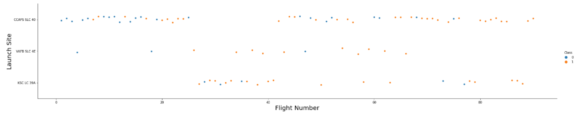
Flight Number vs. Launch Site
Of the three launch sites CCAPS SLC40 was the first used.
In the beginning many launches failed but by the end most launches were successful.

Slide 19
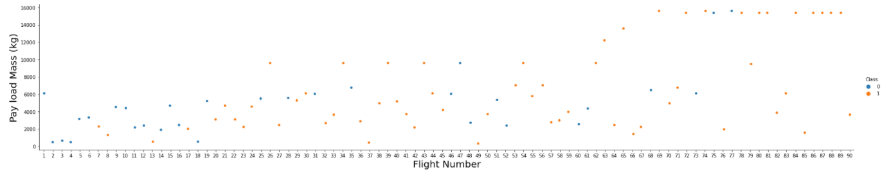
Payload vs. Launch Site
The payload has big influence on the success rate. The heavier the payload the more likely a successful landing.
Towards the end, spaceX almost exclusively used rockets with heavy payload

Slide 20
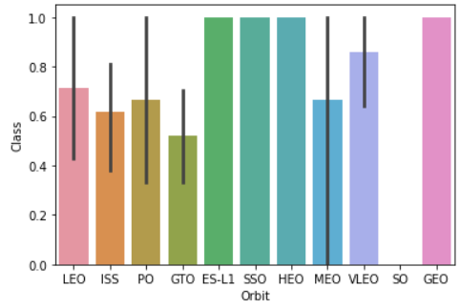
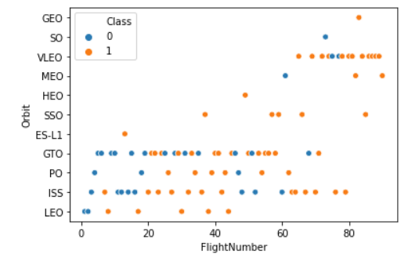
Success Rate vs. Orbit Type
Orbit type and success rate in barchart and scatterplot
VLEO looks almost constantly successful

Slide 21
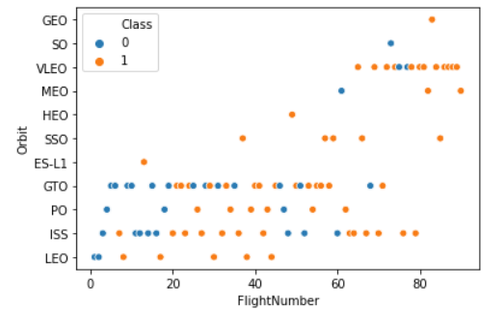
Flight Number vs. Orbit Type
Scatter plot of orbit type by flight number. VLEO orbit resulted in the highest number of successful landings
First spaceX tried many different orbits, but sticks with VLEO

Slide 22
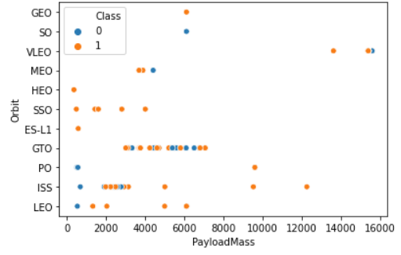
Payload vs. Orbit Type
Payload and Orbit type.
ISS was used first with lower payload
GTO was used later with higher payload

Slide 23
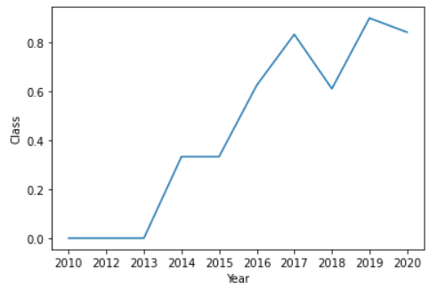
Launch Success Yearly Trend
Landing became more and more successful over the years.
In 2018 there is a drop but 2019 had a recovery

Slide 24
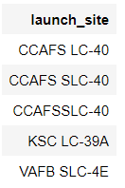
All Launch Site Names
All launch sites:
%sql select Unique(LAUNCH_SITE) from SPACEXTBL;
This creates a new data table with all lauch sites

Slide 25
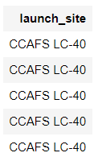
Launch Site Names Begin with 'CCA'
Using SQL magic:
%sql SELECT LAUNCH_SITE from SPACEXTBL where (LAUNCH_SITE) LIKE 'CCA%' LIMIT 5;
We find all lauchsites starting with CCA and limit the results to 5

Slide 26
Total Payload Mass
SELECT SUM(PAYLOAD_MASS__KG_)
FROM SPACEXTBL
WHERE Customer = 'NASA (CRS)’;
Gets us a overall payload of: 45596

Slide 27
Average Payload Mass by F9 v1.1
The average payload mass carried by booster version F9 v1.1 is 340
SELECT AVG(PAYLOAD_MASS__KG_)
FROM SPACEXTBL
WHERE Booster_Version LIKE 'F9 v1.1';

Slide 28
First Successful Ground Landing Date
SELECT MIN(Date)
FROM SPACEXTBL
WHERE Landing__Outcome = 'Success (ground pad)’;
Min(date) finds the first in the list of successful landings

Slide 29
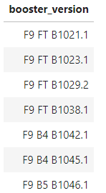
Successful Drone Ship Landing with Payload between 4000 and 6000
SELECT BOOSTER_VERSION
FROM SPACEXTBL
WHERE LANDING__OUTCOME = 'Success (drone ship)'
AND 4000 < PAYLOAD_MASS__KG_ < 6000;
We filter the data by outcome and weight

Slide 30
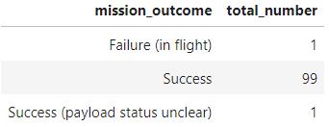
Total Number of Successful and Failure Mission Outcomes
SELECT MISSION_OUTCOME, COUNT(MISSION_OUTCOME)
AS TOTAL_NUMBER
FROM SPACEXTBL
GROUP BY MISSION_OUTCOME;
Find and count all mission outcomes.

Slide 31
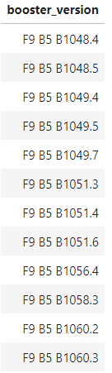
Boosters Carried Maximum Payload
Selecting the max payload from each booster carrier version:
SELECT DISTINCT BOOSTER_VERSION
FROM SPACEXTBL
WHERE PAYLOAD_MASS__KG_ = (
SELECT MAX(PAYLOAD_MASS__KG_)
FROM SPACEXTBL);

Slide 32
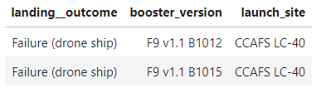
2015 Launch Records
SELECT LANDING__OUTCOME, BOOSTER_VERSION, LAUNCH_SITE
FROM SPACEXTBL
WHERE Landing__Outcome = 'Failure (drone ship)’ AND YEAR(DATE) = 2015;
Find the columns and filter them for failed missions

Slide 33
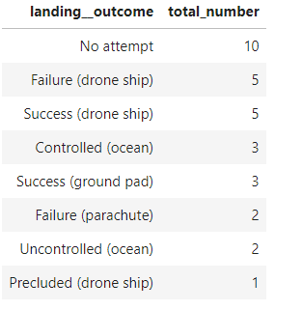
Rank Landing Outcomes Between 2010-06-04 and 2017-03-20
SELECT LANDING__OUTCOME, COUNT(LANDING__OUTCOME) AS TOTAL_NUMBER
FROM SPACEXTBL
WHERE DATE BETWEEN '2010-06-04' AND '2017-03-20'
GROUP BY LANDING__OUTCOME
ORDER BY TOTAL_NUMBER DESC;
Adds up all landing_outcomes in the timeframe

Slide 34


Slide 35
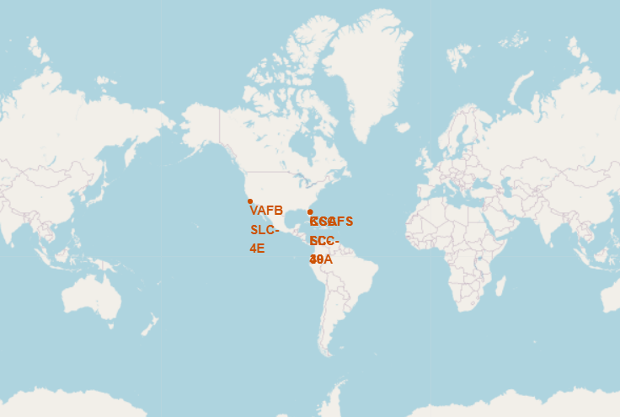
Launchsites of spaceX rockets
There are two major launch locations. One in California and one in Florida.

Slide 36
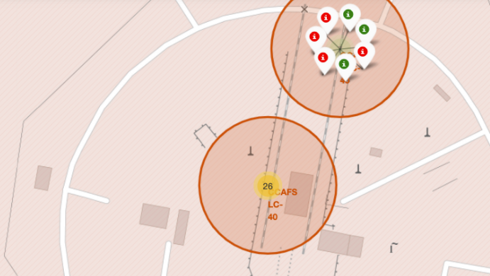
Launch success and failure
Detail of launch site in Florida
Red are failed missions
Green are successful missions

Slide 37
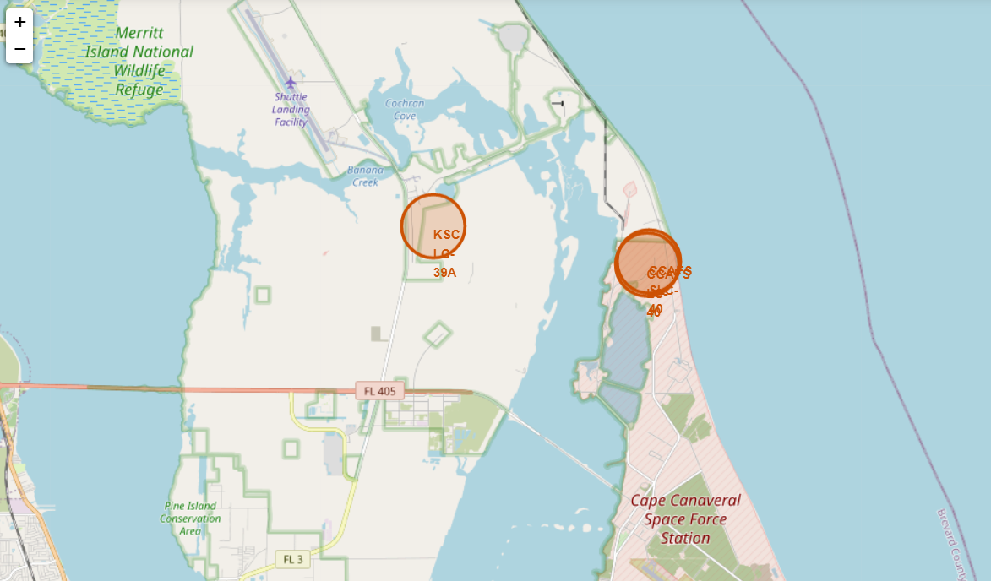
<Folium Map Screenshot 3>
Local area around the launch site
Its near the water!
Railroad tracks are nearby!

Slide 38


Slide 39
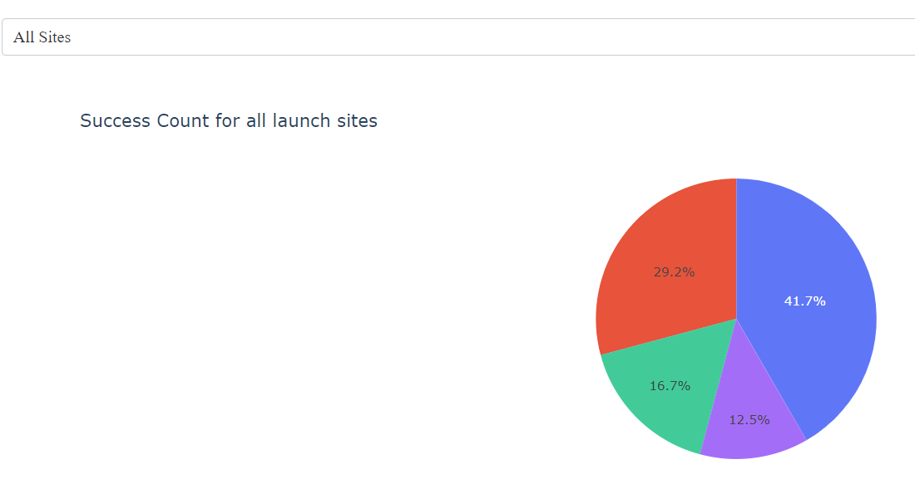
Top of dashboard
Successful launches by launch site
Most successful launches come from the KSC site

Slide 40
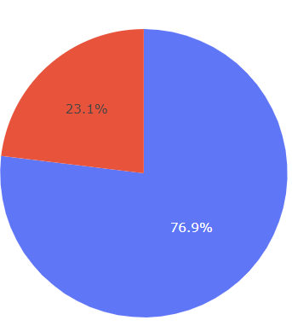
KSC Launch site success rate
Highest success rate of launch site is the KSC site:
76% of Launches are successful

Slide 41
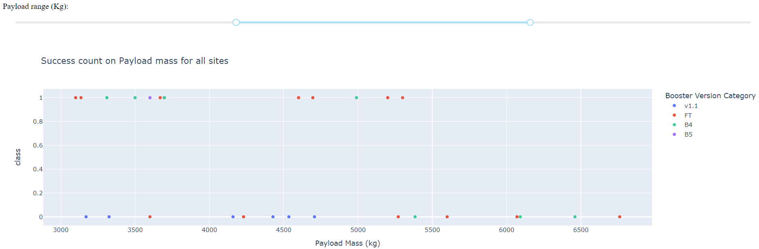
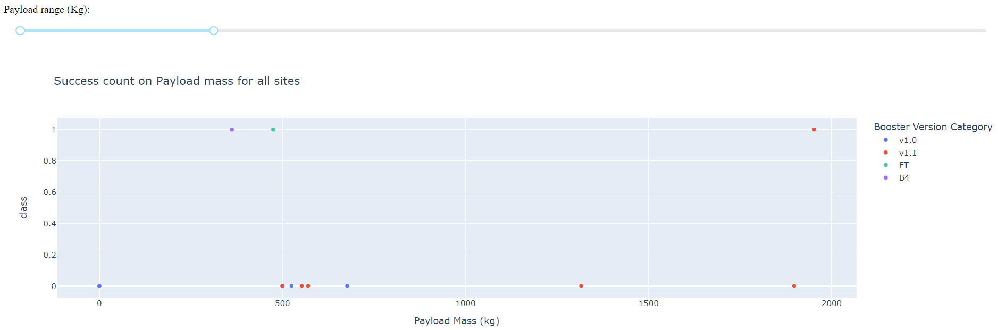
Two sample payload ranges and their success rate
FT boosters are most successful boosters
V1.1 bolsters are the worst.

Slide 42


Slide 43
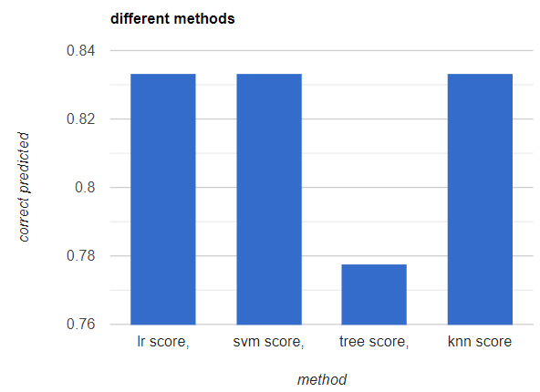
Classification Accuracy
Lr score, svm and knn perform well.

Slide 44
Confusion Matrix
We get high accuracy
But there are many false positives

Slide 45
Conclusions
Point 1: Most launches result in a successful landing
Point 2: The payload correlates with success rate of the landing
Point 3: The landings are getting more successful over time
Point 4: The Orbits LEO and ISS result most likely in a successful landing

Slide 46


